Slide 1
Listening and Responding

Slide 2
Listening and Responding
Beth, do you have my opener to the garage? I can’t find it and I have to take the car or I’ll be late for class.”
“No, but it doesn’t matter because . . .”
“I can’t believe it. I was sure I left it here on the counter last night.”
“Bart, it’s okay . . .”
“It just figures. Just because I’m in a hurry, I can’t find it.”
“Bart, I’ve been trying to tell you, the . . .”

Slide 3
Listening and Responding
“I swear I put it here on the counter. Did you stuff it in a drawer or move it when you were cleaning the kitchen or something?”
“Bart, chill out. The door’s . . .”
“Chill out?! If I’m late, I won’t be able to do my presentation and it’s worth 50 percent of the course grade! I won’t pass the class and I need at least a B to get accepted into the major. Beth, this is a very big deal.”
“Bart, I’ve been trying to tell you . . .”

Slide 4
Listening and Responding
“Oh sure—I just go in to the professor’s office and say, ‘By the way, the reason I wasn’t in class was that I couldn’t find the garage door opener. Can I please do my presentation tomorrow?’ I’ll sound like a slacker who wasn’t ready. There’s no way he’ll buy that argument even though it’s true.”
“Bart, listen!!! I’ve been trying to tell you—I don’t know where your opener is, but I went out this morning and knew you would be leaving soon so I left the door open for you.”
“Geez, Beth, why didn’t you tell me?”

Slide 5
What Is Listening?
People sometimes make the mistake of thinking listening and hearing are the same thing, but they’re not. Hearing is a physiological process, whereas listening is a cognitive process. In other words, listening occurs only when we choose to attach meaning to what we hear.

Slide 6
Importance of Listening
Listening is important for effective communication because 50 percent or more of the time we spend communicating is spent listening (Janusik & Wolvin, 2006). Although most of us have spent a great deal of time learning to read and write, fewer than 2 percent of us have had any formal listening training (Listening Factoid, 2003).
According to research by the International Listening Association, even when we try to listen carefully, most of us remember only about 50 percent of what we hear shortly after hearing it and only about 20 percent two days later.

Slide 7
Types of Listening
Appreciative Listening: Listening for enjoyment.
Discriminative Listening: Listening to understand the meaning of a message.
Comprehensive Listening: Listening to learn or remember.
Empathic Listening: Listening to understand the speakers feelings about the message.
Critical Listening: Listening to evaluate the truthfulness or honesty of a message.

Slide 8
Steps in the Listening Process
Listening is a complex process made up of five steps. These steps are
(a) attending,
(b) understanding,
(c) remembering,
(d) evaluating,
(e) responding to the message.

Slide 9
Steps in the Listening Process: a. Attending
Attending the process of focusing on what a speaker is saying regardless of the potential distractions of other competing stimuli.
1. Get physically ready to listen.
2. Resist mental distractions while you listen.
3. Resist interrupting others.
4. Hear a person out before you react.
5. Observe nonverbal cues.

Slide 10
Steps in the Listening Process: b. Understanding
Decoding a message accurately to reflect the meaning intended by the speaker. We can improve our understanding by asking questions, paraphrasing the message, and empathizing with the speaker.
1. Ask questions to gain additional information.
2. Paraphrase the message to check your understanding.
3. Empathize with the speaker.
Empathic Responsiveness: experiencing an emotional response parallel to, and as a result observing, another person’s actual or anticipated display of emotion.
Perspective Taking: imagining yourself in the place of another; the most common form of empathizing.
4. Sympathetic Responsiveness: Feeling concern, compassion, or sorrow for another because of the other’s situation or plight.

Slide 12
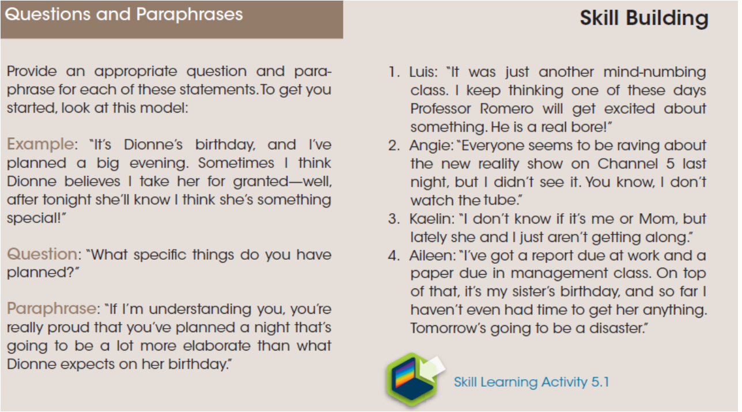

Slide 13
Steps in the Listening Process: C: Remembering
Remembering is being able to retain information and recall it when needed. Three techniques
that can help you improve your ability to remember information are repeating, constructing
mnemonics, and taking notes.
1. Repeat the information.
2. Construct mnemonics.
3. Take notes.

Slide 14
Steps in the Listening Process: D. Evaluating
The fourth listening process is to evaluate or critically analyze what has been said. Evaluation is critically analyzing what you have heard to determine its truthfulness. To evaluate a message, you must learn to separate statements of fact from statements based on inferences. Factual statements are those whose accuracy can be verified as true. Inferences are conjectures which may be based on facts or observations.
Once you’ve determined what in the message is being offered as fact and what is being offered as inference, you need to:
(1) analyze the “facts” to determine if they are true and;
(2) test the inferences to determine whether they are valid.

Slide 15
Steps in the Listening Process: E. Responding
At times, to be truthful and ethical, we will need to disagree with someone or provide negative feedback or a negative critique. When we respond to a friend or family member who appears emotionally upset, respond to a work-group colleague’s ideas, or respond to a public speech by critiquing it, we need to respond supportively. supportive messages are comforting statements that have a goal to reassure, bolster, encourage, soothe, console, or cheer up.
1. Guidelines for responses that offer emotional support: Research suggests several key characteristics of supportive messages in interpersonal settings (Burleson, 2003, pp. 565–568). The following guidelines are based on this research:
• Clearly state that your aim is to help.
Example: “I’d like to help you, what can I do?”

Slide 16
• Express acceptance or affection; do not condemn or criticize.
Example: “I understand that you just can’t seem to accept this.”
• Demonstrate care, concern, and interest in the other’s situation; do not give a lengthy recount of a similar situation.
Example: “What are you planning to do now?” Or “Gosh, tell me more; what happened then?”
• Indicate that you are available to listen and support the other without intruding.
Example: “I know we’ve not been that close, but sometimes it helps to have someone to listen, and I’d like to do that for you.”
• State that you are an ally.
Example: “I’m with you on this.” Or “Well, I’m on your side; this isn’t right.”

Slide 17
• Acknowledge the other’s feelings and situation as well as expressing your sincere sympathy; do not condemn or criticize the other’s behavior or feelings.
Example: “I’m so sorry to see you feeling so bad; I can see that you’re devastated by what has happened.”
• Assure the other that what he or she is feeling is legitimate; do not tell the other how to feel or to ignore his or her feelings.
Example: “With what has happened to you, you have a right to be angry.”
• Use prompting comments to encourage the other to elaborate on his or her story.
Example: “Uh-huh,” “yeah,” or “I see. How did you feel about that?” Or “What happened before that? Can you elaborate?”

Slide 18
2-Guidelines for responses that demonstrate respect when disagreeing or critiquing others
2. Guidelines for responses that demonstrate respect when disagreeing or critiquing others. the following guidelines can help you demonstrate that you respect the person and that your goal is to provide the person with your point of view.
• Use “I” language so that you clearly own the comments you are making and do not ascribe them to others.
Example: “Carla, I really like the way you cited the reference for your opening quotation.”
• Use specific language and specific examples to point out areas of disagreement and areas for improvement.
Example: “I apologize, but I can’t agree to that deadline or to another meeting about this project until I have had a chance to see the entire presentation. I’d suggest that by Monday at 10:00 a.m. each of us e-mails other team members a copy of the report section we are drafting. Then let’s have a short meeting right after class to see if we need to meet again and, if so, to set a time.”

Slide 19
• Find a point to agree with or something positive to say before expressing your disagreement or offering a negative critique.
Example: “I really appreciate what you had to say on this topic. But it was hard for me to follow your argument, and I think that if you had used transitional statements, they could have helped me understand your points better.”

Slide 20
In this course, you may be asked to respond to a speech given by one of your classmates. If so, you will want to remember that your goal is to be supportive, honest, and helpful. A good critique will address three topics: the content of the speech, the structure of the speech, and the delivery of the speech.
• When critiquing the content, you can comment on the appropriateness of the speech for that particular audience and the use of facts and inferences; you can also analyze the logic of the arguments and the evidence used to support ideas.
• When critiquing structure, you can focus on the introduction, the use of transitions, the choice of organizational pattern, and the concluding remarks.
• When critiquing delivery, you can comment on how the speaker used voice and gesture, whether the tone was appropriately conversational or formal, and how effectively the speaker used visual aids such as PowerPoint slides.

Slide 21
Examples of effective and ineffective speech critiques

Slide 22
A summary of the five aspects of listening

Slide 28
Notes based on a lecture on listening

Slide 29
Notes based on a lecture on listening

